Slide 1

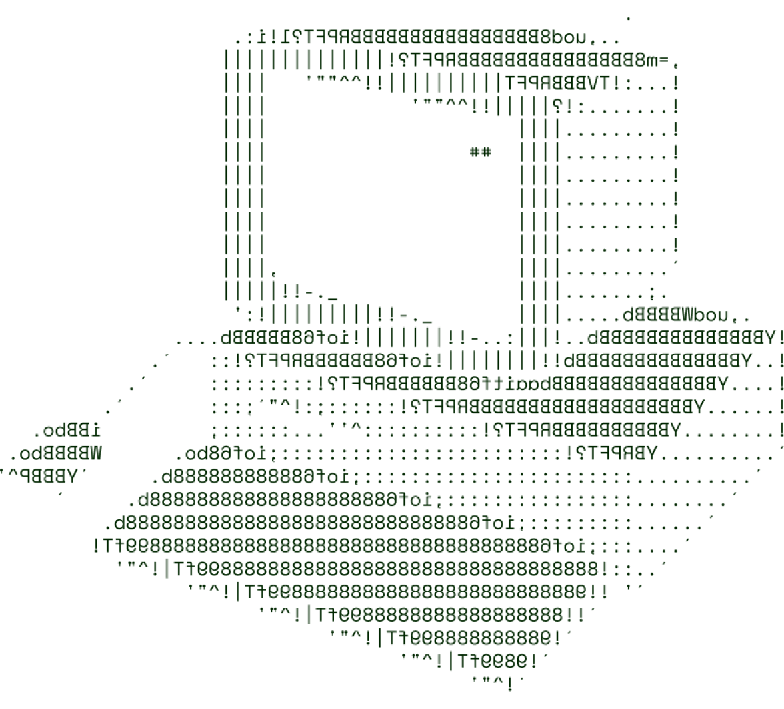
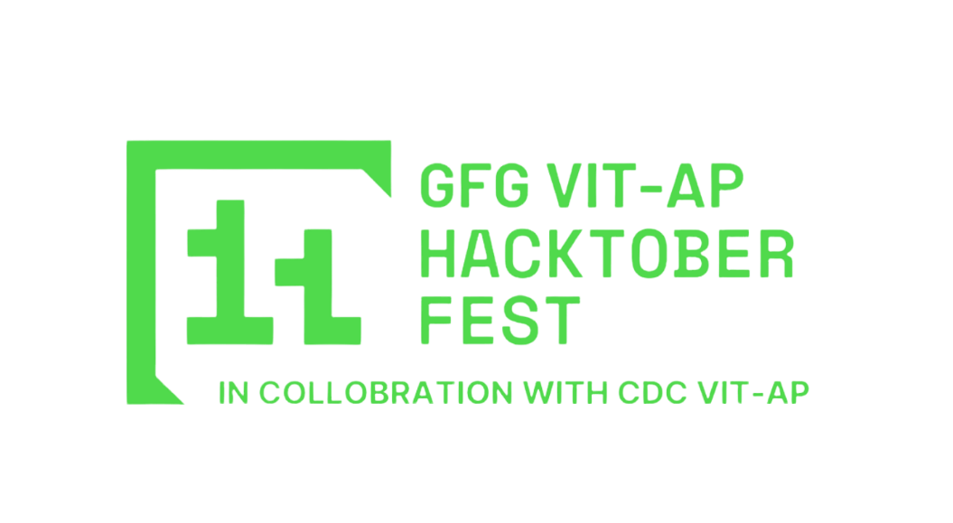
> AgriDOC
Fantastic Four

Slide 2
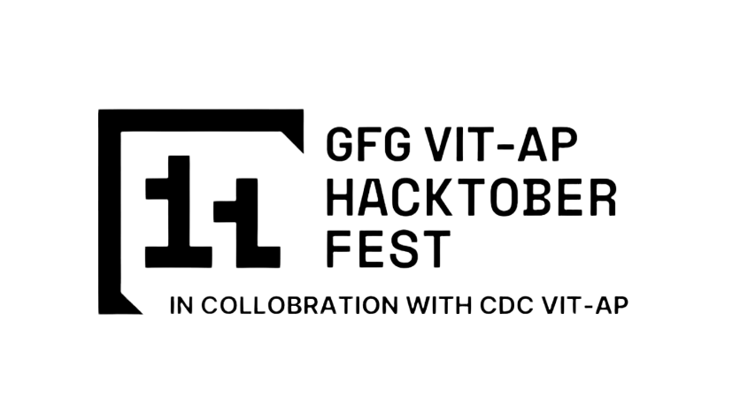
SOLUTION OVERVIEW
This project addresses the critical challenge of crop disease detection, offering farmers an effective tool for timely disease management. Utilizing a multi-class image classification system built on a Convolutional Neural Network (CNN) architecture, the solution can accurately detect different plant diseases across four major crops. The system is accessible via a web app, which interacts with a API to provide real-time analysis and recommendations.
Early Detection The system detects plant diseases at an early stage, alerting farmers as soon as symptoms appear on the leaves. This allows for prompt action to manage the disease and protect the crops from further damage.
Preventive Measures The app also generates a detailed report that farmers can use to seek additional guidance or consult agricultural experts. This proactive approach helps in monitoring crop health continuously.
Impact Reduction In addition to diagnosing the disease for the user, the system notifies nearby farmers about potential outbreaks. This collaborative warning mechanism enables the broader farming community to take preventive actions, limiting the spread of the disease across fields.

Slide 3
TECHNICAL ARCHITECTURE
Tech stack
Frontend Technologies: React.js, CSS, TailwindCSS
Backend Technologies: Node.js, Express.js
Machine Learning Framework: Kares, TensorFlow
Database: MongoDB
Other Tools/Services: Github, Vercel

Slide 4
SCALABILITY AND FUTURE SCOPE
The solution is designed with scalability in mind, using cloud services like Render to host the API, ensuring it can support multiple users simultaneously without compromising performance. As the number of users grows, additional strategies can be employed to enhance scalability and system stability:
Load Balancing: Future integration of load balancing will help distribute incoming traffic evenly across multiple servers, preventing overload and maintaining a consistent user experience even during peak usage.
Microservices Architecture: Adopting a microservices approach in the future will allow for easier management, development, and scaling of individual components. This modular structure will make it simpler to update or add features without affecting the entire system.
The project has significant potential for further development to improve its capabilities and reach:
Expansion of the Detection Model: The system can be extended to cover a wider range of crops beyond cherry, pepper, potato, and tomato, as well as include diseases specific to various regions. This would make it applicable to a more diverse group of farmers worldwide.
Remedy Suggestion After identifying the disease, this web app provides suggestions for effective treatments and remedies. These recommendations are tailored to the specific disease and crop, helping farmers apply the most suitable solutions.
AI Chatbot for Personalized Assistance: Implementing an AI-powered chatbot within the app would offer farmers more personalized support, answering questions, suggesting best practices, and providing tailored advice based on the detected diseases and current conditions.

Slide 5
FEASIBILITY
While the project offers significant benefits, it also faces some challenges that need to be addressed for successful implementation:
Gathering and Maintaining an Updated Dataset of Plant Diseases: Keeping the disease dataset current and comprehensive is crucial for accurate detection. As new plant diseases emerge and existing ones evolve, continuous efforts are needed to update the dataset with relevant and high-quality images.
Managing Network Issues in Rural Areas: Many farmers operate in rural or remote locations where internet connectivity may be limited or unreliable. This poses a challenge for real-time disease detection and updates, potentially limiting the app's accessibility.
To overcome these challenges, we propose the following strategies:
Collaborating with Agricultural Bodies for Updated Disease Data: Partnering with agricultural research institutes, universities, and government agencies can help us access the latest disease data. This collaboration ensures the dataset remains accurate and comprehensive, enhancing the system's detection capabilities.
Offering an Offline Mode in the Application: To accommodate network limitations, the application includes an offline mode where the trained model is stored locally on the device. This allows farmers to use the disease detection feature without internet connectivity and upload data or receive updates once they have access.

Slide 6

>Team Details

Slide 7




Vasantha Kumar S
Harees Kumar V
Student
VIT-AP University
Student
VIT-AP University
Kishore Kumar R
Bharaniprasad P
Student
VIT-AP University
Student
VIT-AP University

Slide 8

Thanks for Joining

